Slide 1
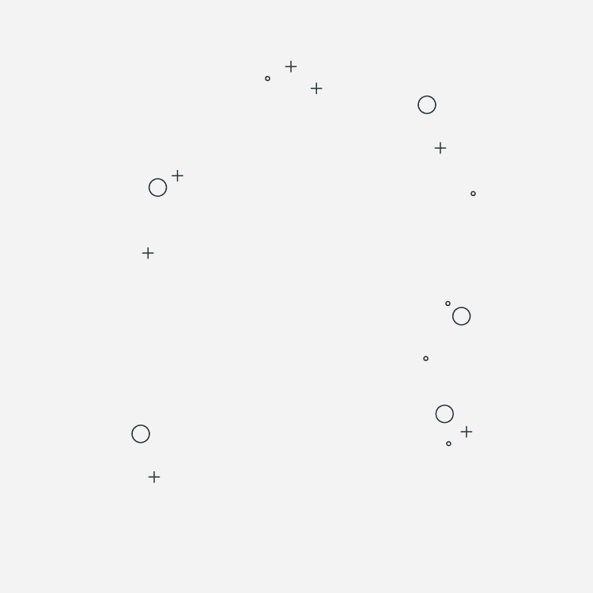

Web graphics Three.js
By Amr Fayez

Slide 2
01
Introduction
02
Project Structure
03
Lighting & Materials
04
Coordination system
05
Textures
06
Animation Loop

Slide 3
07
3D Model Loaders
08
AEC Editor
0
You can describe the topic of the section here
You can describe the topic of the section here

Slide 4

About me
Senior Fullstack
Amro Fayez
01068987680

Slide 5
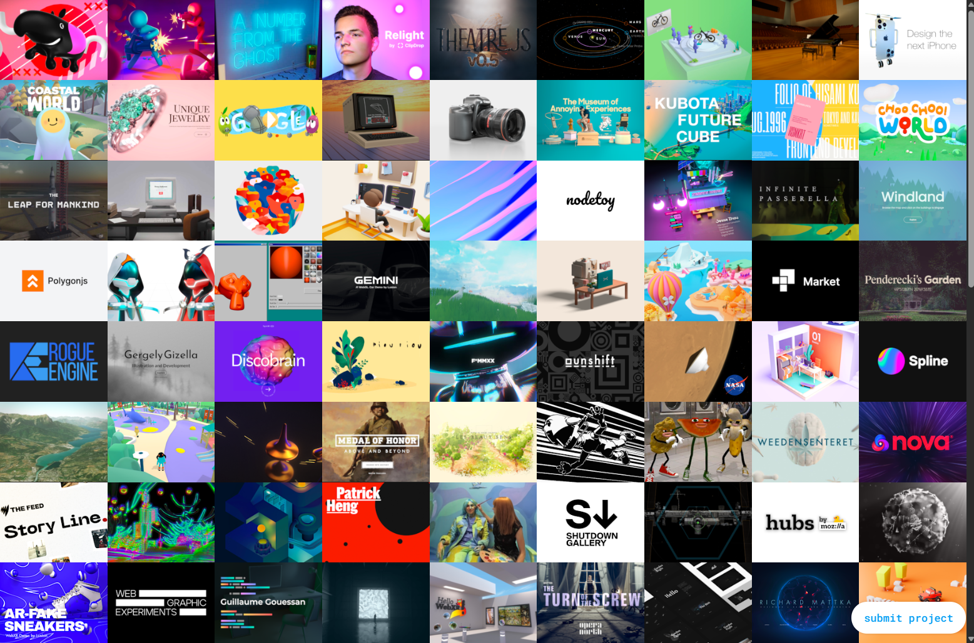
Introduction

Slide 6
Installation

Slide 7
Resources
https://discoverthreejs.com/book/
https://threejs.org/docs/
https://threejs.org/editor/
https://learnopengl.com/Getting-started/Coordinate-Systems

Slide 8
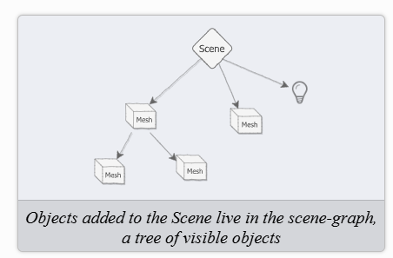
The Scene: a Tiny Universe
The scene is a holder for everything we can see.

Slide 9
The Camera
Think of your 3D scene as a movie set, and the camera in Three.js as the film camera. It determines:
Where you are standing (position)
Where you're looking (direction)
What part of the scene is visible (field of view)
There are several ways to convert the scene graphic into a human vision friendly format, using techniques called projections.

Slide 10
The Camera
Perspective Camera
like the human eye (objects farther away appear smaller)
Orthographic Camera
like architectural drawings (objects stay the same size no matter how far they are)

Slide 11
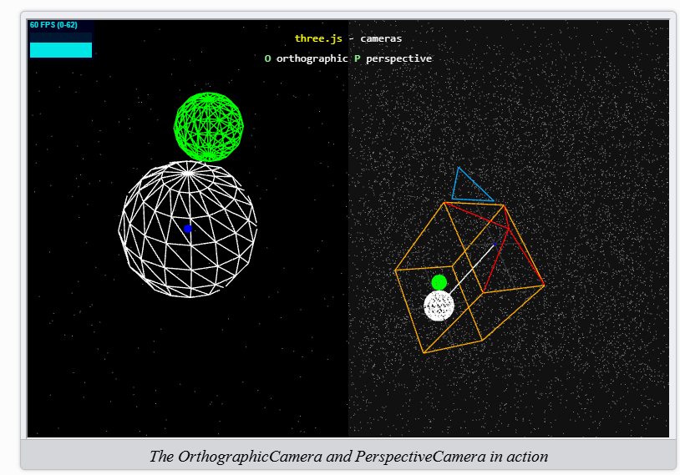
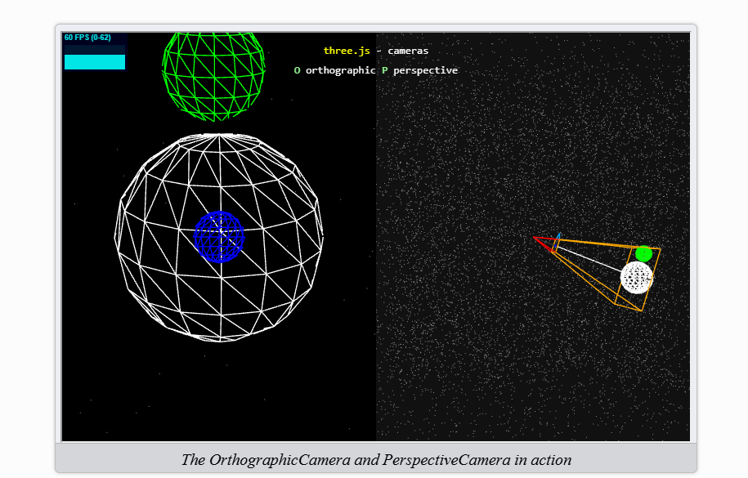
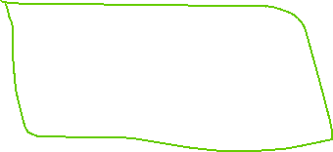

Orthographic Camera
Perspective Camera

Slide 12
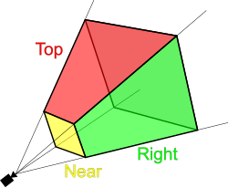
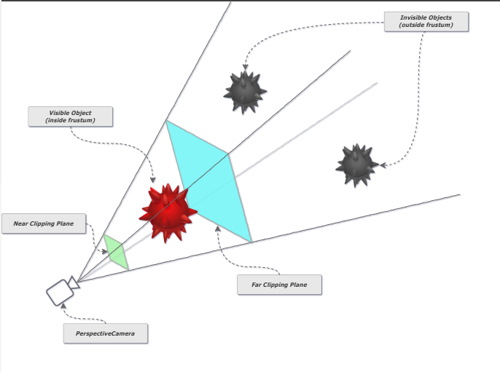
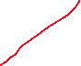


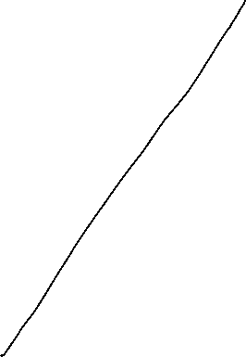

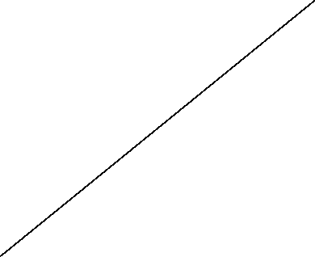


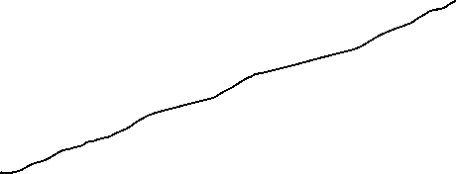



The Camera
Viewing Frustum

Slide 13
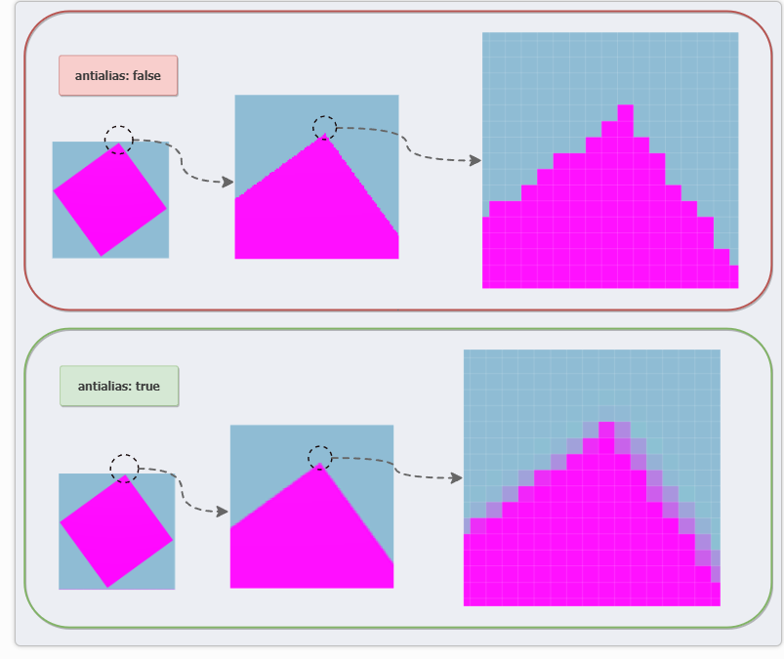
Renderer

Slide 14



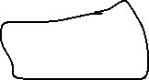





device PixelRatio
devicePixelRatio values other than 1 render the scene at a higher or low resolution and then scale it to fit in the canvas. A DPR of 2 will render the scene at double resolution and scale down, while a DPR of 0.5 will render at half resolution and scale up. As you can imagine, high DPR values are very expensive to render!

Slide 15
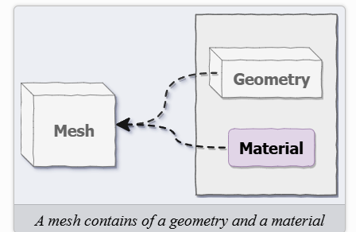
Our First Visible Object: Mesh
A mesh is a 3D object you see in a scene.
It is made of two parts:
Geometry – the shape (like a cube, sphere, etc.)
Material – the appearance (color, texture, transparency)
🧩 Think of it like:
Geometry = mold or skeleton
Material = skin or surface appearance
Together, they form the visible 3D object we render.

Slide 16
Geometry
Geometry Class | Description
BoxGeometry | Cube or rectangular box
SphereGeometry | Sphere
PlaneGeometry | Flat 2D surface
TorusGeometry | Donut shape
CylinderGeometry | Cylinder
BoxGeometry | Cube or rectangular box
SphereGeometry | Sphere
PlaneGeometry | Flat 2D surface
TorusGeometry | Donut shape
CylinderGeometry | Cylinder

Slide 17
Exercise 01
Easy
Change the color of the scene background. You can enter any standard color name such as red, green, purple, and so on, as well as some unusual names like aquamarine or coral. How many of the 140 CSS color names can you guess?
Medium
Change the cube to some other shapes like a rectangle, sphere, triangle, or torus. (Hint: search the docs for “BufferGeometry”.)
Add a second cube and move it around using mesh.position.set(x, y, z) (you’ll either need to figure out some way of returning two cubes from the createCube function, or add a second module like cube2.js).
Hard
Add a button to the HTML page, and delay rendering the scene until the button has been clicked. Do this without making any changes to the World app. Instead, create the button in index.html and set it up in main.js.

Slide 18
Materials
What Are Materials?
Materials define how a 3D surface responds to light and rendering settings — including color, reflectivity, transparency, shading style, and texture usage.
Imagine a cup made of different materials:
Glass → transparent, reflective.
Plastic → smooth and opaque.
Metal → shiny, reflective.
Wood → matte and textured.

Slide 19


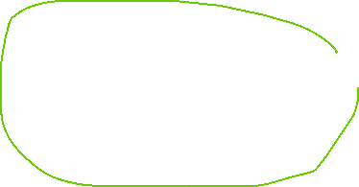

Material
Material Type | Description
MeshBasicMaterial | No lighting, always flat color/texture
MeshStandardMaterial | Responds to light, realistic
MeshPhongMaterial | Shiny with highlights
MeshLambertMaterial | Matte finish, responds to light
BoxGeometry | Cube or rectangular box
SphereGeometry | Sphere
PlaneGeometry | Flat 2D surface
TorusGeometry | Donut shape
CylinderGeometry | Cylinder

Slide 20
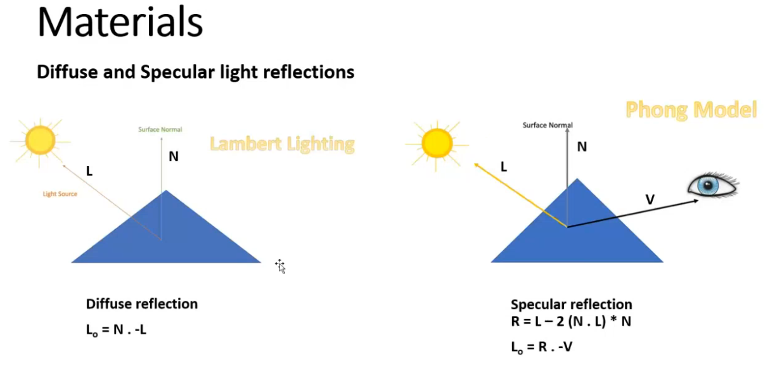

Slide 21
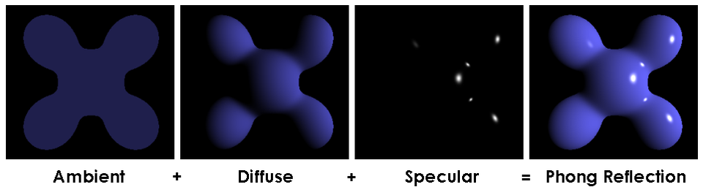
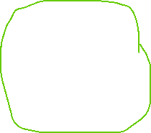
Phong Model

Slide 22
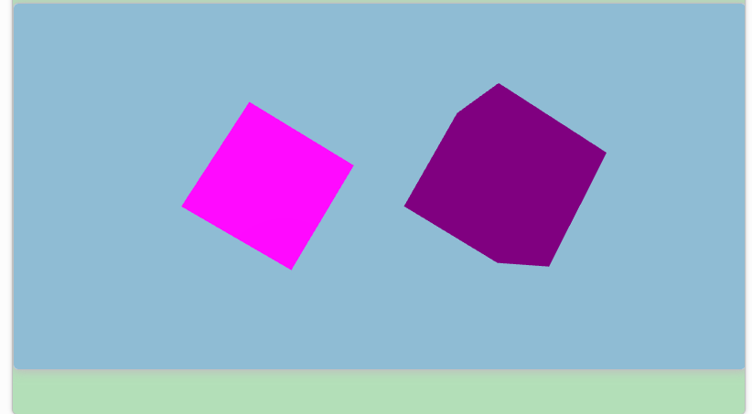
Materials
MeshStandardMaterial vs MeshBasicMaterial

Slide 23
Lighting
Just like in the real world, lighting in 3D graphics determines how we see objects. It affects the appearance of objects by:
Casting shadows
Illuminating surfaces
Creating highlights
Without lighting, your 3D scene would be completely dark, no matter how many objects you add.

Slide 24
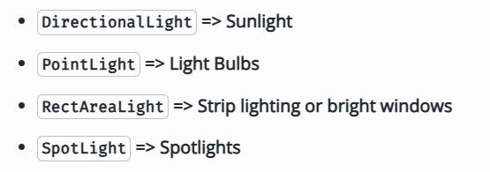
Lighting
🌟 Types of Lights
There are several types of lights in Three.js, and each affects the scene differently:
Ambient Light – general, soft lighting that doesn't have a specific direction (affects everything uniformly).
Point Light – like a light bulb, emits light in all directions.
Directional Light – like the sun, casts parallel light in a specific direction.
Spotlight – like a stage spotlight, shines in a cone shape.
Hemisphere Light – combines a sky color and a ground color, typically for outdoor scenes.

Slide 25
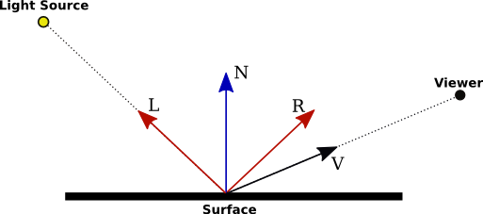


Slide 26
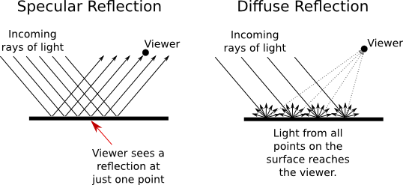


Slide 27
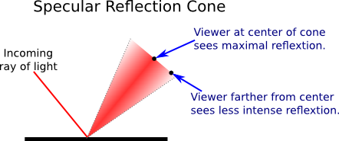
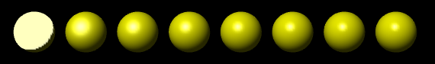
Notes:
https://math.hws.edu/graphicsbook/c4/s1.html

Slide 28
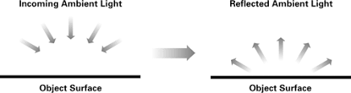
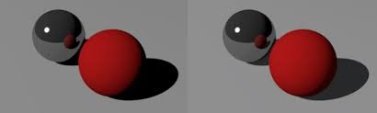
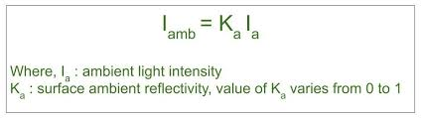
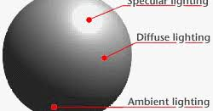
Ambient Light

Slide 29
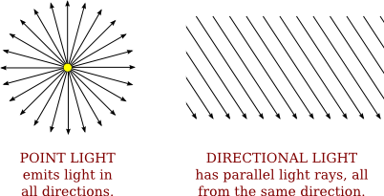



Lights Properties

Slide 30
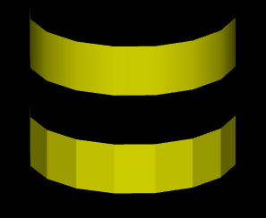
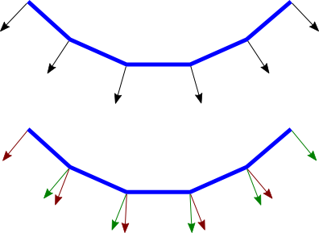


Notes:
The two ways of assigning normal vectors are called flat shading and smooth shading.

Slide 31
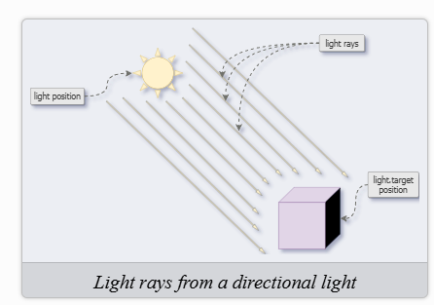
Directional Light
https://threejs.org/docs/scenes/material-browser.html#MeshStandardMaterial
The Material Base Class
Lighting and Depth

Slide 32
Shadow
renderer.shadowMap.enabled = true;
directionalLight.castShadow = true;
mesh.castShadow = true; // For objects that cast shadows
mesh.receiveShadow = true; // For objects that receive shadows

Slide 33
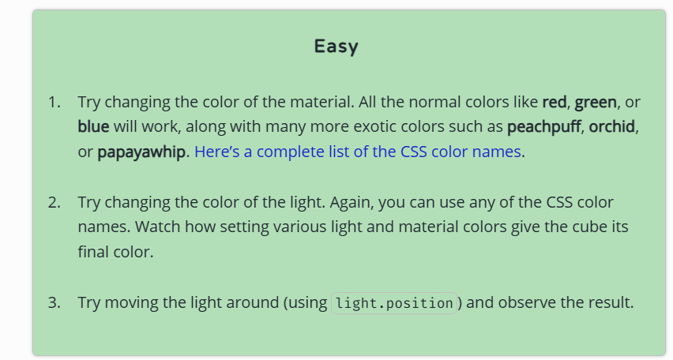
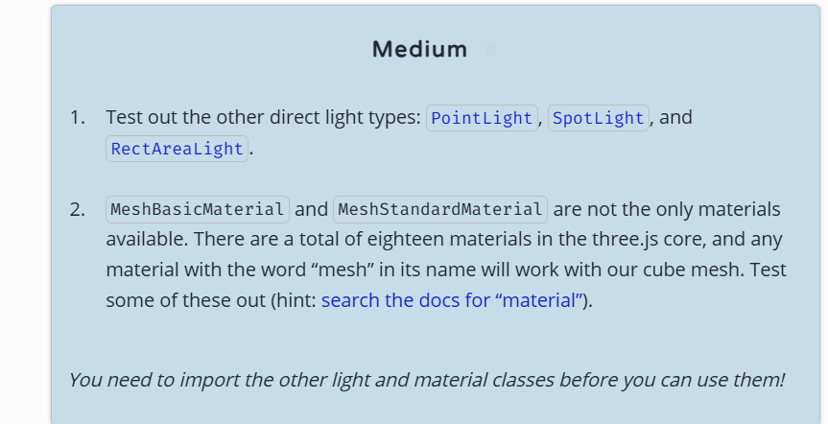
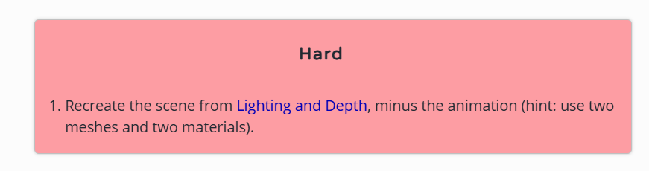

Slide 34
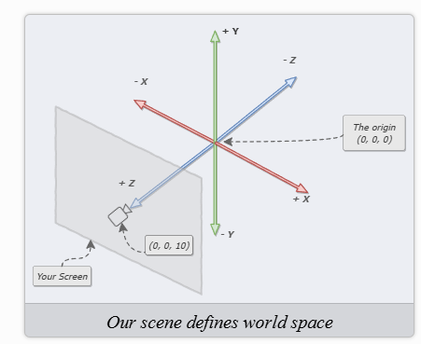
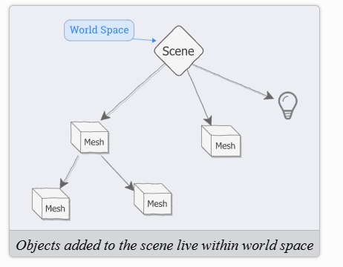



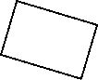

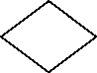

Slide 35
Translation

Slide 36
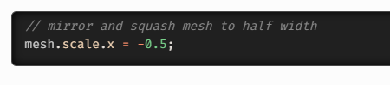
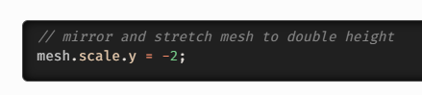
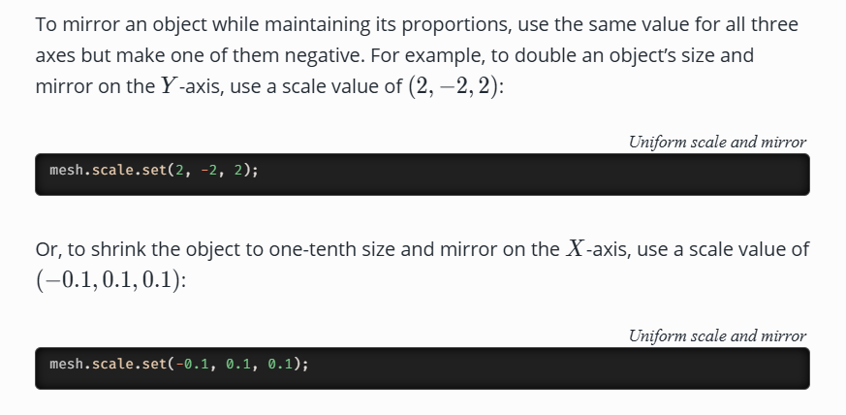
Scaling
Uniform Scaling: Use the Same Value for all Three Axes
Non-Uniform Scaling: Different Scale Values on Each Axis
Negative Scale Values Mirror an Object
Values less than zero and greater than −1 will mirror and squash the object:
Values less than −1 will mirror and stretch the object
Uniform Scale and Mirror

Slide 37
Rotation
the order of rotation matters.
Representing Rotations: the Euler class
Euler Rotation Order
The default order is called ‘XYZ’, but ‘YZX’, ‘ZXY’, ‘XZY’, ‘YXZ’ and ‘ZYX’ are also possible.
The Unit of Rotation is Radians
MathUtils.degToRad(90)

Slide 38
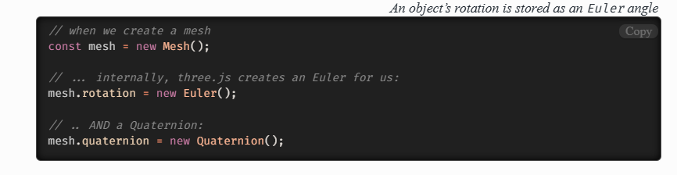
The Other Rotation Class: Quaternions
We can use quaternions and Euler angles interchangeably.

Slide 39
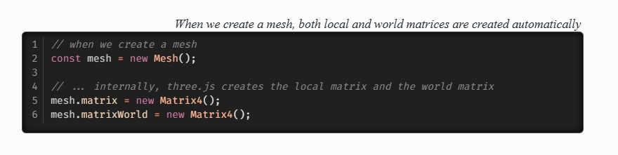
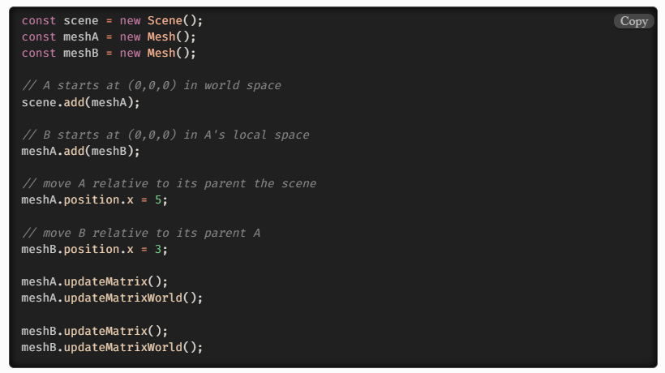
Transformation Matrices
The Local Matrix

Slide 40
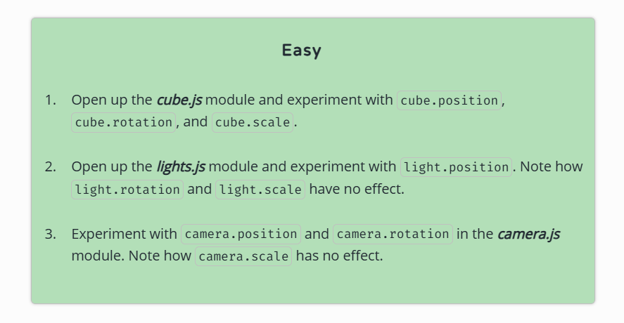
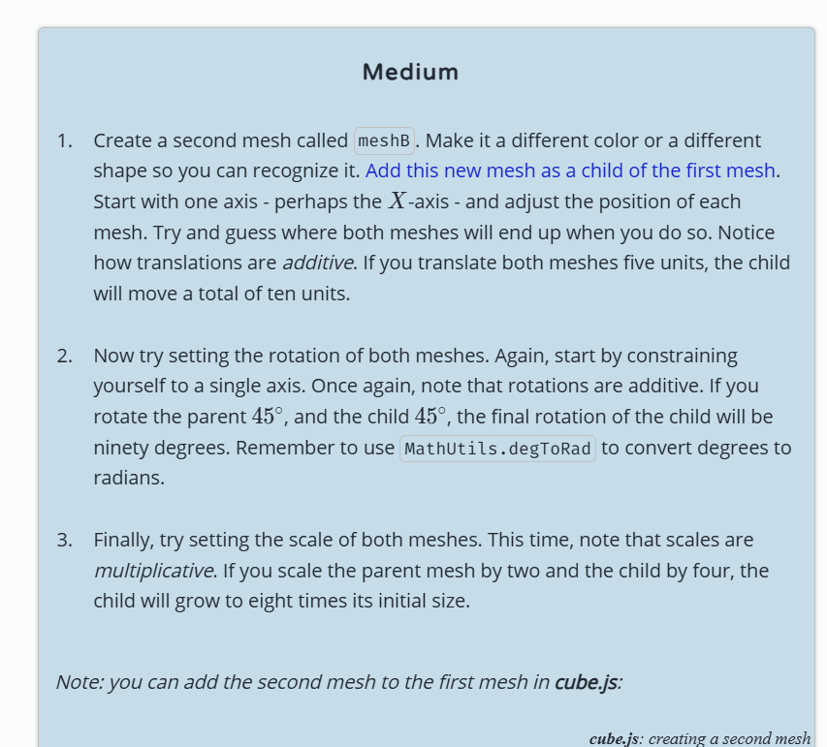
Exercise 03

Slide 41
Bundlers
Webpack
vite

Slide 42
Texture Adding Surface Details
surface detail to 3D models without needing more geometry.
In 3D graphics, highly detailed surfaces (like wrinkles, bricks, or fabric texture)
require a lot of geometry—unless you fake it with textures.
These maps create the illusion of detail or physically deform the surface using grayscale or RGB images.

Slide 43
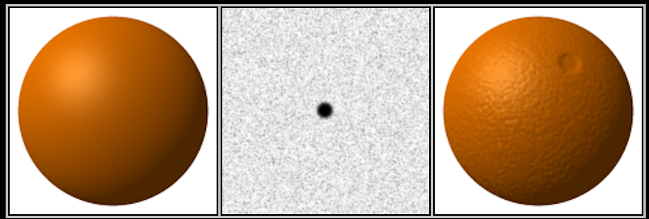
Bump Map
Notes:
Fakes surface height using a grayscale texture—light areas are higher, dark areas are lower—but does not actually change geometry.
How It Works:
Three.js adjusts how light interacts with the surface based on pixel brightness.

Slide 44
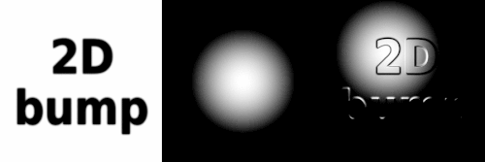

Slide 45

Normal Map
Simulates small surface details by altering how light reflects
Notes:
How It Works:
Each pixel’s RGB value changes how the surface appears to face light—like giving fake bumps and dents—with better quality than bump maps.
What It Does:
Simulates small surface details by altering how light reflects, using an RGB texture that encodes surface angles.

Slide 46


Slide 47

Displacement Map
Notes:
What It Does:
Actually moves vertices of the mesh up/down based on a grayscale map. This modifies the geometry of the surface.
📦 How It Works:
White = high, black = low. More geometry = better detail.

Slide 48


Specular maps
Notes:
A specular map controls how shiny or reflective each part of a surface is. It’s often used in older materials like MeshPhongMaterial.
White areas → strong specular reflection (shiny)
Black areas → dull or no reflection

Slide 49

Ambient Occlusion (AO) Map
https://en.wikipedia.org/wiki/Ambient_occlusion#/media/File:AmbientOcclusion_German.jpg
Notes:
In 3D computer graphics, modeling, and animation, ambient occlusion is a shading and rendering technique used to calculate how exposed each point in a scene is to ambient lighting.

Slide 50


Reflection Maps
Notes:
https://en.wikipedia.org/wiki/Reflection_mapping
An environment map simulates how the environment reflects off an object — even if the environment isn’t fully rendered around the object.
Used for mirror-like materials (metal, chrome, glass, water

Slide 51
Break

Slide 52

UV mapping

Slide 53


Slide 54


Slide 55


https://www.youtube.com/watch?v=J7iZd6mv7VA

Slide 56
Animation Loop
https://discoverthreejs.com/book/first-steps/animation-loop/

